Slide 1


SQL for Humanities
Stephen Worthington
EPCC, Edinburgh University
s.worthington@epcc.ed.ac.uk

Slide 2
Plan of the Workshop
1. Databases using SQL
2. Basic Queries
3. SQL Aggregation
4. Joins and Aliases
Notes:
Just go through the purpose of each section briefly, minute or two tops

Slide 3

1. Databases using SQL
Questions
What is a relational database and why should I use it?
What is SQL?
Objectives
Understand the benefits of using a relational database
Set up a small database from csv files using SQLite
Understand SQLite data types
Notes:
These questions and objectives apply to this section

Slide 4

1. Databases using SQL
Our Dataset
Real Dataset extract from the Text Creation Partnership
It is a time-series for the texts collected and encoded by the Text Creation Partnership
The files we are going to work with are:
authors.csv
titles.csv
dates.csv
pages.csv
eebo.csv

Slide 5
1. Databases using SQL
Querying the Data
How has the length and dates of Martin Luther title attributions changed over time?
What is the average number of each titles, per year?
What information can I learn about Martin Luther species in the 1500s, over time?
What would I need to answer these questions?
Which files have the data I need?
What operations would I need to perform if I were doing these analyses by hand?
Notes:
These are questions to ask the group to think about without SQL

Slide 6
1. Databases using SQL
Workflow
Do you really want to do it manually?
Doing it manually does also imply that whatever change you will have to do to the spreadsheet you will have to repeat the whole path again
Select subsets of the data (rows and columns)
Group subsets of data
Do math and other calculations
Combine data across spreadsheets
Automation of the Data mining!

Slide 7

1. Databases using SQL
What is a Relational Database?
A relational database stores data in relations made up of records with fields. The relations are usually represented as tables; each record is usually shown as a row, and the fields as columns. In most cases, each record will have a unique identifier, called a key, which is stored as one of its fields. Records may also contain keys that refer to records in other tables, which enables us to combine information from two or more sources.
Notes:
Don’t just read this off the board

Slide 8

Why use relational databases?
1. Databases using SQL
It keeps your data separate from your analysis.
This means there’s no risk of accidentally changing data when you analyse it.
If we get new data we can just rerun the query.
It’s fast, even for large amounts of data.
It improves quality control of data entry (type constraints and use of forms in MS Access, Filemaker, Oracle Application Express etc.)
The concepts of relational database querying are core to understanding how to do similar things using programming languages such as R or Python.
Notes:
We’ll not cover type constraints today, but essentially it lets you apply rules to your database, and data will not add to your rdb unless it adheres to those rules

Slide 9
1. Databases using SQL
Database Management Systems
MySQL
PostgreSQL
MS Access
MS SQL Server
Oracle Database
Which one should I use?
Depends on what you need to do.
A few things to take into account:
Size of the Dataset
Single/multiple user
User friendly
Costs
Need to link it to other system (e.g. GIS)
Notes:
What you’ll find though is that the core functionality of all these technologies is largely the same
I initially learned PostgreSQL, subsequently needed to use SQLite and had 0 issues transitioning
When you drill down there are differences to use, but for our level it’s fine

Slide 10


1. Databases using SQL
Let’s start having a look
Open SQLite Manager
Relational databases store data in tables with fields (columns) and records (rows)
Data in tables has types, and all values in a field have the same type (list of data types)
Queries let us look up data or make calculations based on columns
Notes:
*Import the first table here*
You can see the tables in the database by looking at the left hand side of the screen under Tables, where each table corresponds to one of the csv files we were exploring earlier. To see the contents of any table, click on it, and then click the “Browse and Search” tab in the right panel. This will give us a view that we’re used to - just a copy of the table. Hopefully this helps to show that a database is, in some sense, just a collection of tables, where there’s some value in the tables that allows them to be connected to each other (the “related” part of “relational database”).
Relational databases store data in tables with fields (columns) and records (rows)
Data in tables has types, and all values in a field have the same type (list of data types)
Queries let us look up data or make calculations based on columns

Slide 11

1. Databases using SQL
Database Design
Every row-column combination contains a single atomic value, i.e., not containing parts we might want to work with separately.
One field per type of information
No redundant information
Split into separate tables with one table per class of information
Needs an identifier in common between tables – shared column - to reconnect

Slide 12
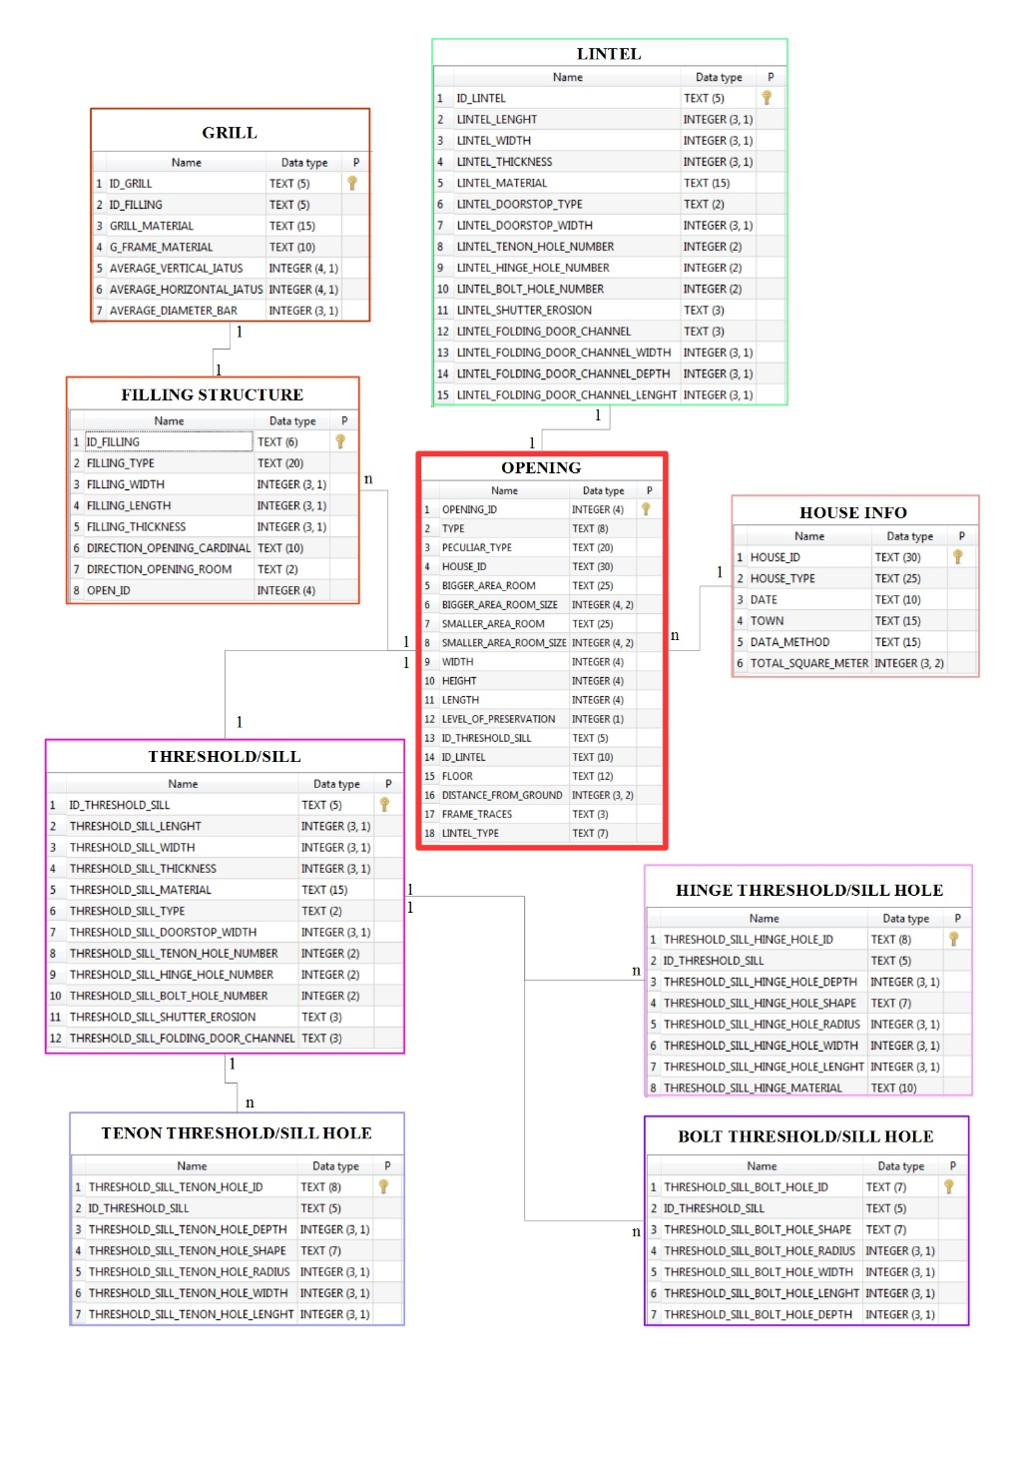

Keying is the key
1. Databases using SQL
Primary key
Secondary/Foreign key
Notes:
We’ll get onto how to use keys with joins later, but for now know that every table will have a column (or columns) whose values are unique, and can therefore be used to identify their row
TCP is the primary key in a lot of the tables we’ll be looking at today

Slide 13
1. Databases using SQL
What is the relationship of your data?
1 to 1: Book and catalogue number
1 to n: one author can have published more than one book
n to n: different authors have published their books in different places
Let’s start building our DataBase
Notes:
authors.csv
titles.csv
dates.csv
pages.csv
eebo.csv
* places.csv

Slide 14
1. Databases using SQL
Data type | Description
CHARACTER(n) | Character string. Fixed-length n
VARCHAR(n) or CHARACTER VARYING(n) | Character string. Variable length. Maximum length n
BINARY(n) | Binary string. Fixed-length n
BOOLEAN | Stores TRUE or FALSE values
VARBINARY(n) or BINARY VARYING(n) | Binary string. Variable length. Maximum length n
INTEGER(p) | Integer numerical (no decimal).
SMALLINT | Integer numerical (no decimal).
INTEGER | Integer numerical (no decimal).
BIGINT | Integer numerical (no decimal).
DECIMAL(p,s) | Exact numerical, precision p, scale s.
NUMERIC(p,s) | Exact numerical, precision p, scale s. (Same as DECIMAL)
FLOAT | Approximate numerical
DOUBLE PRECISION | Approximate numerical
DATE | Stores year, month, and day values
TIME | Stores hour, minute, and second values
TIMESTAMP | Stores year, month, day, hour, minute, and second values
INTERVAL | Composed of a number of integer fields, representing a period of time, depending on the type of interval
ARRAY | A set-length and ordered collection of elements
MULTISET | A variable-length and unordered collection of elements
XML | Stores XML data

Slide 15
1. Databases using SQL
Data type | Access | SQLServer | Oracle | MySQL | PostgreSQL
boolean | Yes/No | Bit | Byte | N/A | Boolean
integer | Number (integer) | Int | Number | Int / Integer | Int / Integer
float | Number (single) | Float / Real | Number | Float | Numeric
currency | Currency | Money | N/A | N/A | Money
string (fixed) | N/A | Char | Char | Char | Char
string (variable) | Text (<256) / Memo (65k+) | Varchar | Varchar2 | Varchar | Varchar
binary object OLE Object Memo Binary (fixed up to 8K) | Varbinary (<8K) | Image (<2GB) Long | Raw Blob | Text Binary | Varbinary

Slide 16
1. Databases using SQL
Key Points Summary
SQL allows us to select and group subsets of data, do math and other calculations, and combine data.
A relational database is made up of tables which are related to each other by shared keys.
Different database management systems (DBMS) use slightly different vocabulary, but they are all based on the same ideas.

Slide 17

2. Basic Queries
Questions
How do I write a basic query in SQL?
Objectives
Write and build queries.
Filter data given various criteria.
Sort the results of a query.

Slide 18

2. Basic Queries
SQL queries repository
SELECT (what do we want to see)
FROM (in which table this info is stored)
WHERE (condition)
Notes:
This is the basic structure of a SQL query, so I think we should spend a few minutes here doing some example so we all know what that looks like
We won’t look at WHERE just yet, but it lets you filter results, which we’ll come on to
SELECT Title FROM eebo;
SELECT Title, TCP FROM eebo;
SELECT * FROM eebo;
** Mention capitalisation

Slide 19

2. Basic Queries
Limiting Results
What if we want to see just the first 5, 10, etc rows?
Unique values
Single occurrences of one value or a combination of values
LIMIT
SELECT DISTINCT
SELECT *
FROM eebo
LIMIT 10;
SELECT DISTINCT Date FROM eebo;
Notes:
SELECT *
FROM eebo
LIMIT 10;
SELECT DISTINCT Date FROM eebo;
Don’t forget to demo distinct pairs!
SELECT DISTINCT Date, Title FROM eebo;

Slide 20
2. Basic Queries
Challenge
Write a query that returns the year, EEBO and page length
Solution:
﻿SELECT date, EEBO, pagecount
FROM eebo;

Slide 21
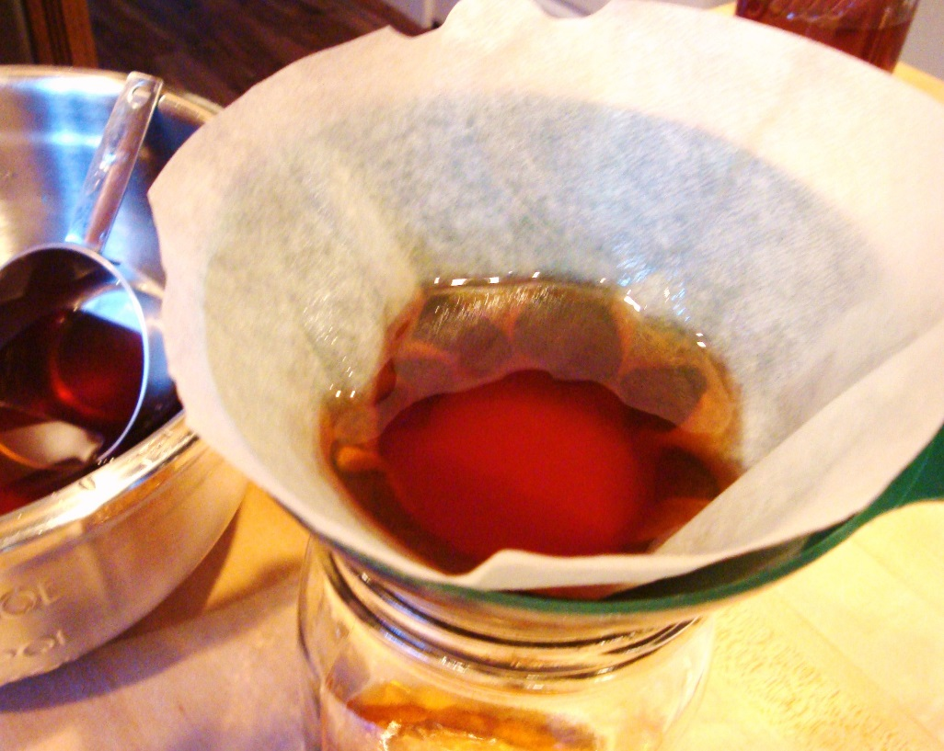
2. Basic Queries
Filtering
What if you want to see just the data meeting a certain criteria
E.g. Only the titles that have the place London
WHERE
Combine more than one condition with AND / OR
Notes:
SELECT * FROM eebo WHERE place=‘London’;
**Now talk about conditional operators**
SELECT * FROM eebo WHERE date >= '1600’;
SELECT * FROM eebo WHERE (date >= '1600') AND (place=‘London’);
SELECT * FROM eebo WHERE date >= '1600' AND date <= '1620'

Slide 22
2. Basic Queries
Challenge 2
Produce a table listing the data for all titles in the catalogue with a page length more than 75, telling us the date, eebo id code, and page.
Solution:
﻿SELECT date, EEBO, pagecount
FROM eebo
WHERE pagecount > '75';

Slide 23

2. Basic Queries
Building more complex queries
Now, lets combine the above queries to get data for 2 authors from the year 1580 on.
Start simple
When the queries become more complex, it can be useful to add comments. In SQL, comments are started by --, and end at the end of the line. For example, a commented version of the above query can be written as :
Link together
-- Get post 1580 data on authors
-- These are in the eebo table, and we are interested in all columns
SELECT *
FROM surveys
-- Sampling year is in the column `Date`, and we want to include after 1580
WHERE (year >= 2000)
-- Author names
AND (author IN ('Aylett, Robert, 1583-1655?', 'Bacon, Francis, 1561-1626.'));
Notes:
SELECT * FROM eebo WHERE (date >= '1580') AND (author IN ('Aylett, Robert, 1583-1655?', 'Bacon, Francis, 1561-1626.’));
We started with something simple, then added more clauses one by one, testing their effects as we went along. For complex queries, this is a good strategy, to make sure you are getting what you want. Sometimes it might help to take a subset of the data that you can easily see in a temporary database to practice your queries on before working on a larger or more complicated database.

Slide 24
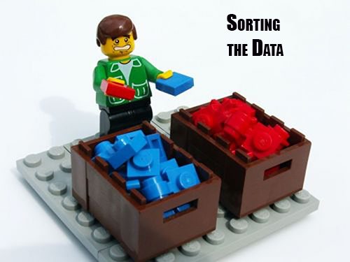
2. Basic Queries
Sorting
We can also sort the results of our queries
How do we want our data to be displayed
ASC
DESC
ORDER BY
Notes:
SELECT * FROM eebo;
SELECT * FROM eebo ORDER BY date ASC;
SELECT * FROM eebo ORDER BY date DESC;
SELECT * FROM eebo ORDER BY date;
SELECT * FROM eebo ORDER BY Date ASC, Author ASC;

Slide 25
2. Basic Queries
Challenge 3
Write a query that returns year, TCP id, and page from the catalogue table, sorted with the largest page lengths at the top.
Solution:
﻿SELECT date, TCP, pagecount
FROM eebo
ORDER BY pagecount DESC;

Slide 26
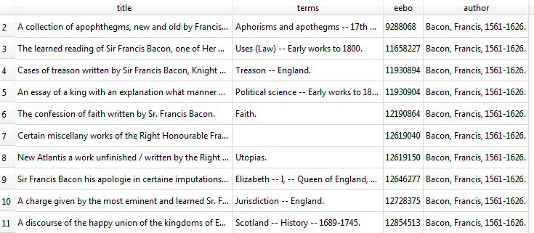
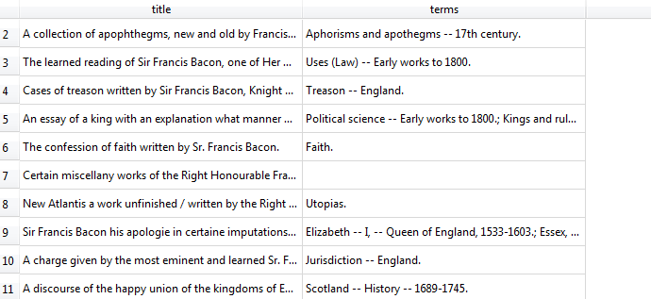
2. Basic Queries
Order of execution
Another note for ordering. We don’t actually have to display a column to sort by it.
Eg. If we want to show title and terms of Francis Bacon ordered by EEBO we don’t need to show either the EEBO or the Author
We can do this because sorting occurs earlier in the computational pipeline than field selection.
The computer is basically doing this:
Filtering rows according to WHERE
Sorting results according to ORDER BY
Displaying requested columns or expressions.
Notes:
SELECT Title, Terms, eebo, author FROM eebo WHERE author = 'Erasmus, Desiderius, d. 1536.' ORDER BY eebo ASC;
SELECT Title, Terms FROM eebo WHERE author = 'Erasmus, Desiderius, d. 1536.' ORDER BY Terms ASC;

Slide 27
2. Basic Queries
Challenge 4
Let’s try to combine what we’ve learned so far in a single query. Using the catalogue table write a query to display the author, title, and terms field for titles before 1600, ordered alphabetically by the author.
Write the query as a single line, then put each clause on its own line, and see how more legible the query becomes!
Solution:
﻿SELECT author, title, terms
FROM eebo
WHERE date < '1600'
ORDER BY author ASC;

Slide 28
2. Basic Queries
Key Points summary
It is useful to apply conventions when writing SQL queries to aid readability.
Use logical connectors such as AND or OR to create more complex queries.
Adding comments in SQL helps keep complex queries understandable.

Slide 29

3. SQL Aggregation
Questions
How can I summarize my data by aggregating, filtering, or ordering query results?
Objectives
Apply aggregation to group records in SQL.
Filter and order results of a query based on aggregate functions.
Save a query to make a new table.
Apply filters to find missing values in SQL.

Slide 30

3. SQL Aggregation
COUNT and GROUP BY
Aggregation allows us to combine results by grouping records based on value and calculating combined values in groups
Calculate and sum all the possible combination of values
Eg. What if we want to know how many pages there are in total?
MIN | returns the smallest value in a given column
MAX | returns the largest value in a given column
SUM | returns the sum of the numeric values in a given column
AVG | returns the average value of a given column
COUNT | returns the total number of values in a given column
COUNT(*) | returns the number of rows in a table
Notes:
SELECT COUNT(*) FROM eebo;
SELECT COUNT(*), SUM(PageCount) FROM eebo;
SELECT COUNT (DISTINCT author) from eebo;

Slide 31
3. SQL Aggregation
Challenge 1
Write a query that returns: total page length, average page length, and the min and max page lengths for all titles encoded over the duration of the project. Can you modify it so that it outputs these values only for books published before 1601?
Solution:
﻿SELECT SUM(PageCount), MIN(PageCount), MAX(PageCount), AVG(PageCount)
FROM eebo
WHERE date <= '1600';

Slide 32
3. SQL Aggregation
Challenge 2
Write queries that return:
How many groups of terms were created in each year
in total
per author
Average number of each term groupings in each year.
Can you modify the above queries combining them into one?
GROUP BY
The GROUP BY statement is often used with aggregate functions (COUNT, MAX, MIN, SUM, AVG) to group the result-set by one or more columns.
Solution:
﻿SELECT COUNT(terms), date, author
FROM eebo
GROUP BY date
ORDER BY author;
Notes:
Group By example
SELECT TCP, COUNT(*) FROM eebo GROUP BY Status;
Challenge
1a.
SELECT COUNT(terms), date
FROM eebo
GROUP BY date
1b.
2.
3.

Slide 33

3. SQL Aggregation
HAVING Keyword
Filter the results based on aggregate functions.
E.g. we can adapt the last request we wrote to only return information about page length with a count higher than 100
The HAVING keyword works exactly like the WHERE keyword, but uses aggregate functions instead of database fields.
If you use AS in your query to rename a column, HAVING can use this information to make the query more readable. For example, in the above query, we can call the COUNT(pages)by another name, like page.
Notes:
SELECT TCP, PageCount
FROM eebo
GROUP BY PageCount
HAVING pagecount > ‘200';

Slide 34
3. SQL Aggregation
Challenge 3
Write a query that returns from the Authors table, the EEBO(TCP) ids in each author, only for the authors with 2 or more works
Solution:
﻿SELECT TCP, Author, count(*) as count
FROM Authors
GROUP BY author
HAVING count > 1

Slide 35


3. SQL Aggregation
Ordering Aggregated Results
Saving Queries for Future Use
Sometimes you need to repeat the same operation. SQL comes with a very powerful mechanism to do this: views. Views are a form of query that is saved in the database, and can be used to look at, filter, and even update information.
One way to think of views is as a table, that can read, aggregate, and filter information from several places before showing it to you.
The results can be ordered both on a field value or on an aggregation result
CREATE VIEW viewname AS
Notes:
Aggregating ordered;
SELECT author, COUNT(*)
FROM eebo
GROUP BY author
ORDER BY COUNT(author) DESC;
Viewname
SELECT * FROM eebo WHERE (date > '1558' AND date < '1603’);
CREATE VIEW elizabethan AS SELECT * FROM eebo WHERE (date > '1558' AND date < '1603');

Slide 36
3. SQL Aggregation
Key Points Summary
Use the GROUP BY keyword to aggregate data.
Functions like MIN, MAX, AVERAGE, SUM, COUNT, etc. operate on aggregated data.
Use the HAVING keyword to filter on aggregate properties.
Use a VIEW to access the result of a query as though it was a new table.

Slide 37
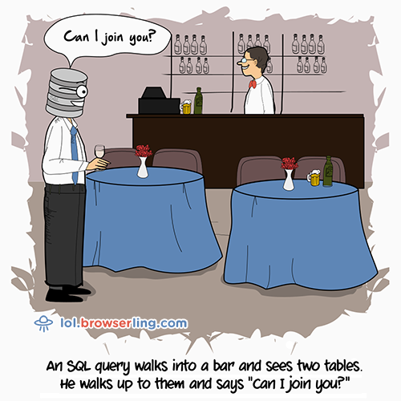
4. Joins and Aliases
Questions
How do I bring data together from separate tables?
How can I make sure column names from my queries make sense and aren’t too long?
Objectives
Employ joins to combine data from two tables.
Apply functions to manipulate individual values.
Employ aliases to assign new names to items in a query.

Slide 38

4. Joins and Aliases
Joins
To combine data from two tables we use the SQL JOIN command, which comes after the FROM command.
The JOIN command on its own will result in a cross product, where each row in first table is paired with each row in the second table. Usually this is not what is desired when combining two tables with data that is related in some way.
For that, we need to tell the computer which columns provide the link between the two tables using the word ON.
The two table to be joined need to share a field (normally primary and foreign key respectively)

Slide 39
4. Joins and Aliases
Example of a Join
We want to return all information from our authors table, mapped to the dates they published works
SELECT *
FROM authors
JOIN dates
ON authors.TCP = dates.TCP;
Notes:
Alternatively!
SELECT * FROM authors JOIN dates USING (TCP);

Slide 40
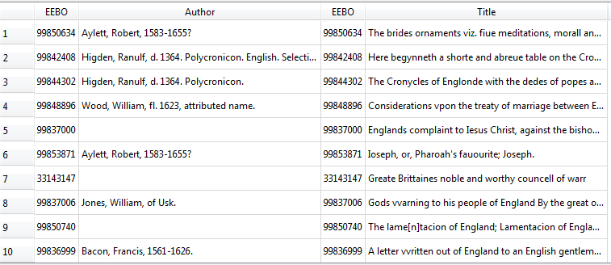
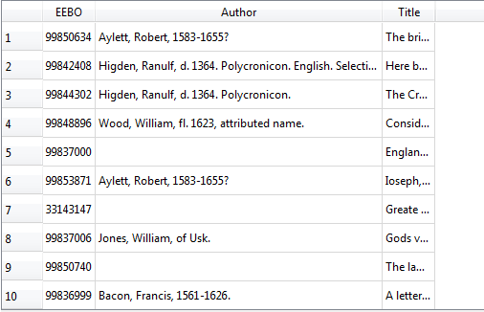
4. Joins and Aliases
Join on (where) VS Join using
We often won’t want all of the fields from both tables, so anywhere we would have used a field name in a non-join query, we can use table.colname.
Notes:
SELECT * FROM authors JOIN dates USING (TCP);
SELECT authors.Author, dates.Date FROM dates JOIN authors ON dates.TCP = authors.TCP;

Slide 41
4. Joins and Aliases
Challenge 1
Write a query that returns the places and authors of every TCP ID captured in the catalogue
Solution
﻿﻿SELECT places.place, authors.Author
FROM places
JOIN authors ON
places.TCP = authors.TCP
Notes:
Without using the eebo table

Slide 42

4. Joins and Aliases
Notes:
We can count the number of records returned by our original join query.
SELECT COUNT(terms), date
FROM eebo
GROUP BY date
Notice that this number is smaller than the number of records present in the catalogue data.
SELECT COUNT(*) FROM authors;
SELECT titles.TCP, titles.Title, Authors.Author
FROM authors
LEFT JOIN titles
ON authors.TCP = titles.TCP
SELECT titles.TCP, titles.Title, Authors.Author
FROM titles
LEFT JOIN authors
ON authors.TCP = titles.TCP

Slide 43

4. Joins and Aliases
Challenge 2
Re-write the original query to keep all the entries present in the Catalogue table
Count the number of records in the catalogue table that have a NULL value in the EEBO column
Solution
SELECT authors.author, catalogue.terms, catalogue.pages
FROM catalogue
LEFT JOIN authors
ON catalogue.eebo = authors.eebo
SELECT authors.author, catalogue.terms, catalogue.pages
FROM catalogue
LEFT JOIN authors
ON catalogue.eebo = authors.eebo
WHERE catalogue.eebo IS NULL

Slide 44

4. Joins and Aliases
Combining joins with sorting and aggregation
Joins can be combined with sorting, filtering, and aggregation. So, if we wanted average mass of the individuals on each different type of treatment
SELECT authors.author, AVG(eebo.PageCount)
FROM eebo
JOIN authors
ON authors.TCP = eebo.TCP
GROUP BY eebo.PageCount;

Slide 45
4. Joins and Aliases
Challenge 3
Write a query that returns the number of authors who have published in each year, in descending order
Write a query that finds the average pages of each year of publication
Solution
﻿SELECT COUNT(authors.author), eebo.title, eebo.date
FROM eebo
JOIN authors
ON authors.TCP = eebo.TCP
GROUP BY eebo.date
ORDER BY eebo.date DESC;
﻿﻿SELECT AVG(pages.PageCount) as average, dates.date
FROM dates
JOIN pages
ON pages.TCP = dates.TCP
GROUP BY dates.date
ORDER BY average DESC;

Slide 46
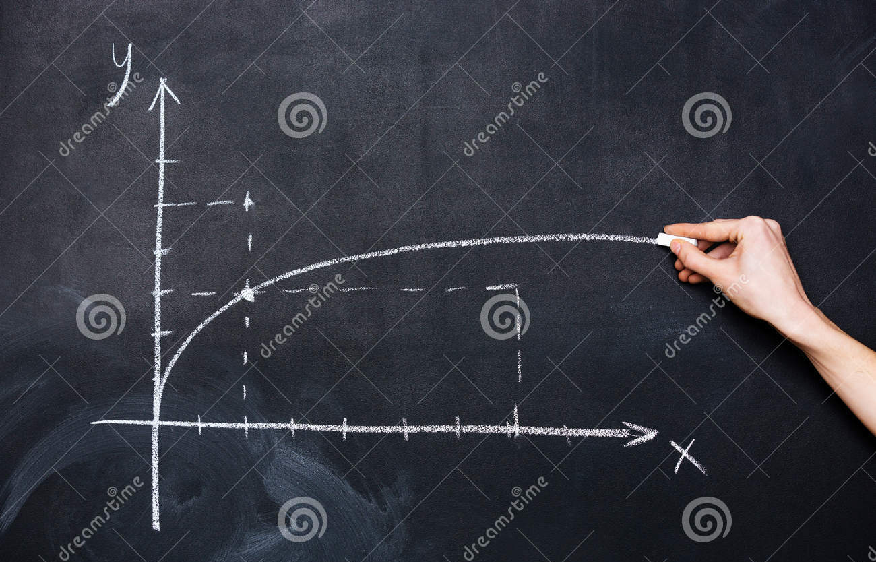
4. Joins and Aliases
Functions
SQL includes numerous functions for manipulating data. You’ve already seen some of these being used for aggregation (SUM and COUNT) but there are functions that operate on individual values as well. Probably the most important of these are IFNULL and NULLIF. IFNULL allows us to specify a value to use in place of NULL.
We can represent unknown ids with “U” instead of NULL:
﻿SELECT TCP, Place, IFNULL(Place, 'U')
FROM places;
Notes:
The lone “Place” column is only included in the query above to illustrate where IFNULL has changed values; this isn’t a usage requirement.
﻿SELECT TCP, IFNULL(Place, 'U')
FROM places;

Slide 47
4. Joins and Aliases
Challenge 4
Write a query that returns ‘NP’ instead of NULL for values in the authors column.
Solution
SELECT Author, IFNULL(Author, ‘NP’)
FROM authors;
Really useful when you have a join, can you guess why?

Slide 48
4. Joins and Aliases
Nullif
Is the opposite of ifnull and restore to NULL the wanted array of data.
This is useful for “nulling out” specific values.
We can “null out” London:
SELECT TCP, Place, NULLIF(Place, 'London’)
FROM eebo;

Slide 49
4. Joins and Aliases
SQL functions
Function | Description
ABS(n) | Returns the absolute (positive) value of the numeric expression n
LENGTH(s) | Returns the length of the string expression s
LOWER(s) | Returns the string expression s converted to lowercase
NULLIF(x, y) | Returns NULL if x is equal to y, otherwise returns x
ROUND(n) or ROUND(n, x) | Returns the numeric expression n rounded to x digits after the decimal point (0 by default)
TRIM(s) | Returns the string expression s without leading and trailing whitespace characters
UPPER(s) | Returns the string expression s converted to uppercase

Slide 50
4. Joins and Aliases
SQLite specific functions
Function | Description
IFNULL(x, y) | Returns x if it is non-NULL, otherwise returns y
RANDOM() | Returns a random integer between -9223372036854775808 and +9223372036854775807.
REPLACE(s, f, r) | Returns the string expression s in which every occurrence of f has been replaced with r
SUBSTR(s, x, y) or SUBSTR(s, x) | Returns the portion of the string expression s starting at the character position x (leftmost position is 1), y characters long (or to the end of s if yis omitted)

Slide 51
4. Joins and Aliases
Challenge 5
Write a query that returns author names, sorted from longest titles name down to shortest.
Solution
SELECT author, LENGTH(author)
FROM eebo
ORDER BY LENGTH(author);

Slide 52
4. Joins and Aliases
Aliases
As queries get more complex names can get long and unwieldy (as we saw before). To help make things clearer we can use aliases to assign new names to things in the query.
AS
Table names
Column names
Notes:
SELECT dt.Date, auth.Author FROM dates AS dt JOIN authors AS auth ON dt.TCP = auth.TCP;

Slide 53
4. Joins and Aliases
Key Points Summary
Use the JOIN command to combine data from two tables—the ON or USING keywords specify which columns link the tables.
Regular JOIN returns only matching rows. Other join commands provide different behavior, e.g., LEFT JOIN retains all rows of the table on the left side of the command.
IFNULL allows you to specify a value to use in place of NULL, which can help in joins
NULLIF can be used to replace certain values with NULL in results
Many other functions like IFNULL and NULLIF can operate on individual values.
Aliases can help shorten long queries. To write clear and readible queries, use the AS keyword when creating aliases.

Slide 54
Last Challenge
Have a look at the following questions; these questions are written in plain English. Can you translate them to SQL queries and give a suitable answer?
How many entries from each year are there per year?
How many years have similar amounts of books published?
Solution
SELECT date as year, count(*) FROM eebo GROUP BY year ORDER BY year DESC
SELECT date as year, count(*) AS volumes FROM eebo GROUP BY year ORDER BY volumes DESC

Slide 55
